Slide 1

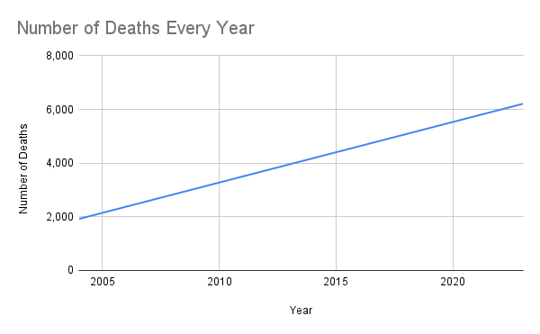
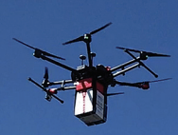
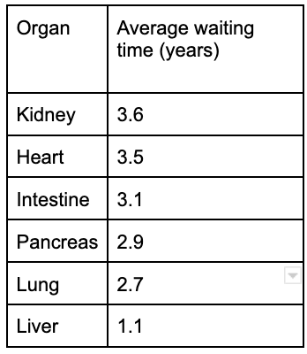
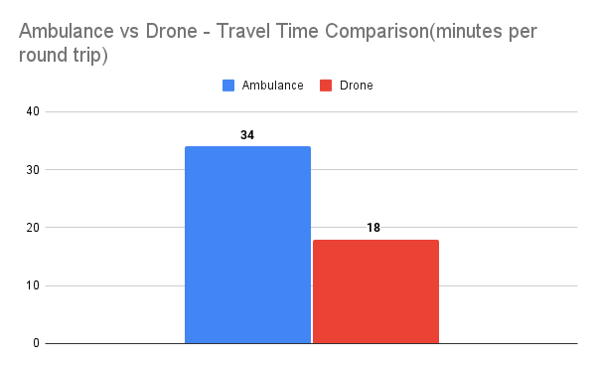
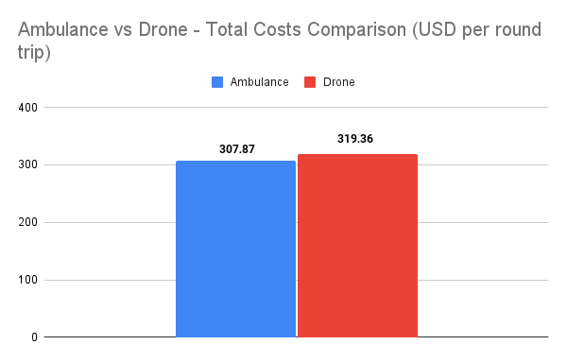
Utilization of Drones in Organ Deliveries
Yelizaveta Semikina, University of Illinois at Chicago, College of Engineering
Abstract
Identification of an Organization: Identified an organization specializing in organ transplantation in the US which is UNOS (United Network for Organ Sharing) and gathered relevant data from the organization such as number of people waiting for transplants, organ transplants every day, average waiting time for various organs.
Organ Transportation
Successful Human Kidney Transportation: The research achieved the successful transportation of a human kidney for transplantation using a drone.
Drone Modification: The researchers modified a DJI M600 Pro drone specifically for this task, enhancing its capabilities for organ transportation.
Specialized Transport Box: A specialized transport box, crafted from lightweight carbon fiber, was created for the safe and secure transportation of the fragile human organ.
Safety Features: The modified drone was equipped with advanced safety features, including stabilization systems, obstacle detection sensors, and redundant communication links.
Far-Reaching Implications: This breakthrough has profound implications for organ transplantation, extending beyond densely populated urban areas to a global scale.
Efficiency and Environmental Friendliness: Drones offer a faster, more efficient, and environmentally friendly alternative to traditional organ transportation methods, potentially revolutionizing the field.
Security Challenges in Drone Communications
Challenges:
Identifying and addressing security challenges in drone communications is vital.
Key Areas:
Data Integrity: Ensuring data protection and integrity is a top priority.
Attack Detection: Implementing robust systems to detect and respond to potential threats.
Latency Optimization: Reducing communication delays for real-time drone operations.
Network Control: Enhancing control over communication networks supporting drones.
Solutions:
Blockchain: Secure drone communications and data through blockchain technology.
Machine Learning: Detect and combat security threats with machine learning.
Fog Computing: Reduce latency and enhance security with fog computing.
Software Defined Networks (SDN): Optimize network resources dynamically with SDN for secure drone communications. Addressing security challenges is crucial for the growing use of drones across various sectors, particularly in healthcare.
Implications:
Addressing security challenges is crucial for the growing use of drones across various sectors, particularly in healthcare.
This research focuses on the applications of drones which can be fully or partially autonomous but are more often controlled remotely by a human pilot. Drones are environmentally friendly, cost effective, and faster than the traditional last mile delivery methods for congested or isolated locations. Adopting drone technologies has shown potential to advance services in healthcare operations such as delivery of medications, lab-specimens, laboratory supplies, medical instruments and supplies, blood samples including biopsy for emergency surgeries, antibiotics, drug supplies, and vaccinations, among others. Time is a critical factor for life/death if these are not delivered when needed.
This research discusses whether drones are viable means to deliver organs in terms of providing a more sustainable and resilient technology that can withstand current and future challenges.
Background
Introduction: Organ transplantation is a life-saving medical procedure that is time-sensitive and critical. Methods of organ delivery often face limitations in terms of speed and reliability.
Organ Delivery Methods: Ground transportation has been the conventional mode for organ transportation. However, it has limitations in terms of speed, especially in congested or isolated locations.
Role of Drones: Drones, with their cost-effectiveness, eco-friendliness, and speed, have emerged as a potential solution for healthcare operations. They are already being utilized for medical deliveries.
Objective: This research aims to assess the viability of using drones for organ delivery and transplantation in healthcare, with the goal of enhancing the sustainability and resilience of this life-critical operation.
Significance: Adopting drones for organ delivery holds the promise of saving more lives and addressing the challenges faced by current delivery methods.
Figure 2: The table indicates death rates from the delay in organ deliveries.
Data Analysis: Analyzed the data collected from the literature review, drone specifications, and insights from the organization involved in organ transplantation. Created charts and tables such as ambulance vs. drone travel time and its cost per round trip or average waiting time for organ transplant.
Figure 6: DJI M600 Pro drone with a specialized transport box for the organ.
Figure 3: The table indicates
the average waiting time for
receiving organ.
Conclusion
Methods
Results
Drone technology has the potential to transform healthcare by significantly reducing organ transportation times.
Despite cost concerns, the time-saving benefits of drones make them a feasible option for healthcare logistics.
Addressing security challenges is essential for safe drone operations, and technologies like blockchain and machine learning can provide solutions.
The integration of drones holds great promise for the future of healthcare delivery, offering efficient and timely solutions.
Economic evaluation studies reveal that, despite higher costs, drone transportation significantly reduces travel time for blood products between hospitals.
Drones complete round trips in about half the time taken by ambulances, improving cost-effectiveness due to time savings.
As drone technology matures and becomes more cost-effective, it could offer an efficient mode of transportation for time-sensitive medical situations, especially in regions with challenging terrain or heavy traffic.
Literature Review: Conducted a literature review for the following articles:
The potential of drones to revolutionize healthcare and organ transportation, emphasizing the benefits of faster, more efficient access to medical services and organ delivery is addressed, while the researchers acknowledged the importance of overcoming challenges such as safety concerns, regulatory hurdles, and the need for further research [4,9].
Security challenges in drone communications and ethical considerations associated with humanitarian drones are discussed [6,7].
[1, 5, 8] The researchers highlight how drone technology offers faster, more efficient, and cost-effective alternatives, addressing critical time sensitivity in healthcare, even as they acknowledge the need for addressing regulatory and operational challenges for their widespread adoption in the healthcare sector.
The authors in articles [2, 3] collectively showcase groundbreaking advancements in the use of drones for healthcare applications, with the first article successfully demonstrating the use of a custom drone for human organ transportation, potentially revolutionizing organ delivery. Furthermore, article [2] highlights the importance of user-centered research in drone-based medical supply delivery.
Data Collection - Drone Specifications: Compiled a comprehensive database of drones suitable for healthcare applications and documented specifications of the identified drones, including capacity, flight range, manufacturer, year made, among many others. A few of examples:
Economic Evaluation: The economic evaluation study compared the use of drones and ambulances for transporting blood products between hospitals. It revealed that although drone transportation incurred higher costs, it significantly reduced travel time. Drones completed round trips in about half the time taken by ambulances, contributing to improved cost-effectiveness due to time savings. This suggests that as drone technology matures and becomes more cost-effective, it could provide an efficient mode of transportation for time-sensitive medical situations, especially in regions with challenging terrain or heavy traffic.
References
Zailani, M.A., Azma, R.Z., Aniza, I. et al. Drone versus ambulance for blood products transportation: an economic evaluation study. BMC Health Serv Res 21, 1308 (2021). https://doi.org/10.1186/s12913-021-07321-3
Stephan F, Reinsperger N, Grünthal M, Paulicke D, Jahn P (2022) Human drone interaction in delivery of medical supplies: A scoping review of experimental studies. PLOS ONE 17(4): e0267664. https://doi.org/10.1371/journal.pone.0267664
Scalea, J. R., Pucciarella, T., Talaie, T., Restaino, S., Drachenberg, C. B., Alexander, C., Qaoud, T. A., Barth, R. N., Wereley, N. M., & Scassero, M. (2021). Successful Implementation of Unmanned Aircraft Use for Delivery of a Human Organ for Transplantation. Annals of surgery, 274(3), e282–e288. https://doi.org/10.1097/SLA.0000000000003630
Talaie T, Niederhaus S, Villalongas E, et alInnovating organ delivery to improve access to care: surgeon perspectives on the current system and future use of unmanned aircraftsBMJ Innovations 2021;7:157-163.
M. Hampson, "Drone delivers human kidney: The organ was flown several kilometers by a drone without incurring damage - [News]," in IEEE Spectrum, vol. 56, no. 1, pp. 7-9, Jan. 2019, doi: 10.1109/MSPEC.2019.8594776.
M. Krichen, W. Y. H. Adoni, A. Mihoub, M. Y. Alzahrani and T. Nahhal, "Security Challenges for Drone Communications: Possible Threats, Attacks and Countermeasures," 2022 2nd International Conference of Smart Systems and Emerging Technologies (SMARTTECH), Riyadh, Saudi Arabia, 2022, pp. 184-189, doi: 10.1109/SMARTTECH54121.2022.00048.
Wang, N., Christen, M. & Hunt, M. Ethical Considerations Associated with “Humanitarian Drones”: A Scoping Literature Review. Sci Eng Ethics 27, 51 (2021). https://doi.org/10.1007/s11948-021-00327-4
Andrew T. Sage et al. ,Testing the delivery of human organ transportation with drones in the real world.Sci. Robot.7,eadf5798(2022).DOI:10.1126/scirobotics.adf5798
Krey, M., & Seiler, R. (2019). Usage and acceptance of drone technology in healthcare : exploring patients and physicians perspective [Conference paper]. Proceedings of the 52nd Hawaii International Conference on System Sciences, 4135–4144. https://doi.org/10.21256/zhaw-3372
Big thanks to Dr. Unsal Ozdogru, Clinical Assoc. Prof. of Information and Decision Sciences (IDS) for supervising this capstone project.
Figure 4: The Bar Chart indicates the travel time of the ambulance vs drone.
Drone | Manufacturer | Customers | Release Year
Zipline P2 | Zipline | Rwanda Ministry of Health | 2023
Vayu X5 | Vayu Aerospace | World Health Organization (WHO), United Nations Population Fund (UNFPA) | 2023
Google Wing | Google | Google, Stanford Health Care, UCHealth | 2023
Parcelcopter | DHL | Tanzania government | 2018
Figure 5:The Bar Chart indicates the cost per trip for the ambulance vs drone.
Figure 1: This part of the table presents drones and their specifications.

